Slide 1


Transforming Engineering Practices and Processes at Microsoft
Rob Beneson
PRINCIPAL GROUP ENGINEERING MANAGER
Martin O’Flaherty
PRINCIPAL PM MANAGER
Engineering Fundamentals
Microsoft Core Services Engineering and Operations (CSEO)

Slide 2
Core Services Engineering and Operations is on a journey to modernizing our engineering processes to be customer-obsessed, data-driven, speed-oriented, and quality focused.

Slide 3

What we’ll cover today
Core service engineering and operations
Move to the cloud
Being metric driven
Modernizing the pipeline
Feedback driven development
What we have learned

Slide 4
Core Service Engineering and Operations (CSEO)

Slide 5
Core Service Engineering & Operations Building deploying, and managing the critical products, processes and services that run Microsoft
Legal
Human Resources
Finance
Professional Services
Sales & Marketing
Retail
Business
Operations
Corporate Functions
SMSE
End User Services
Engineering Fundamentals (Eng. System and Telemetry)
Core Platform
Networking, Infrastructure, Enterprise Application Services and Supply Chain
Digital Security and Risk Engineering
1 Azure DevOps Account
16 Minute Average Build Time
640 Releases per Day
820 Services in Heirarchy
2800 Builds per Day
3500 Git Code Repos
5500 Engineers/PMs
66,000 Commits per Day
Notes:
Talk track (2-3 mins):
Introduce CSEO
Talk about the breadth of what we do. Our engineering system supports 3.5K engineers
First adopters of Microsoft Products at enterprise Scale is relevant in the context of how we use 1ES such as Azure DevOps
Talk briefly about the different business lines we support and the fact our engineering pipeline under pines this

Slide 6

Our modern engineering journey (2017–present)
To transform our operating model, we asked ourselves
How will we transform our operating models and functions?
How will we build, develop and operate our products?
How will we integrate and unify our standards like a modern engineering group?
Future
Today
3 years ago
Rapid delivery and experimentation
Auto-detection and self healing of incidents
Enhanced build/release pipelines
End-to-end business process monitoring
Tooling to enhance developer productivity
Migration to GitHub
Coherent design system
Vision led with well defined business priorities
Centralized on Azure DevOps with a fully defined service catalog
Centralized incident management system
Centralized build & release policies
Centralized notification system for eng actions
Centralized telemetry capturing and reporting
End to end customer feedback loops
No centralized vision
Siloed organizations and decentralized funding
70% of engineering outsourced
Independent and disparate tools and standards
No cross-org visibility to engineering metrics
No consistency in design
Majority of application moved to the cloud

Slide 7
The need to modernize
Pain points
Goals
Services not consistently reliable and incidents take too long to resolve
Establish a live site first culture with reviews and postmortems
Learn from our mistakes and ‘embrace the red’
Build muscle around monitoring and auto-detecting
Services don’t consistently comply with security, privacy, and accessibility policies
Burning down technical debt
Strategize about which metrics to go after first
Build security and compliance directly into the pipeline
New business capabilities are not delivered on a continuous basis
Leverage the best tools and practices from across the company
Give engineers the time and space to innovate
Enable teams to share code, continuously release, and safely deploy using deployment rings, experimentation, and feedback loops
User experiences aren’t always intuitive and well-designed
Create standard set of design components and libraries to build coherent user experiences

Slide 8

Technical debt
Getting into a good state
Before we begin to modernize, we first must deal with years of technical debt
Investment of 20%–40% of dev capacity per sprint required from all teams for 12 months to start to get healthy
Start with the fundamentals, the problem is often much larger
Maintaining a good state
Leverage Cloud Leads to help prioritize metrics within the following buckets:
Engineering Fundamentals
Security and Compliance
Accessibility
Live Site and Service Health
Cloud optimization

Slide 9
Move to the cloud

Slide 10

Move to a cloud-centric architecture
Scale to meet changing business demands
Keeping pace with the needs of our customers as they continuously expand
Discovering meaningful business insights that fuel innovation
Enabling our customers to be productive wherever they are
Notes:
Slide objective
Explain how cloud computing enables businesses to meet user expectations.
Talking points
Core Services Engineering (CSE) views the cloud platform as critical for the future of IT. We’re investing in adoption to support a range of IT needs.
Speaker notes
Core Services Engineering views the cloud platform as critical for the future of IT. We’re investing in adoption to support a range of IT needs. By using the cloud platform we’re:
Scaling to meet business demands in a changing landscape.
Keeping pace with the needs of our customers as they continuously expand.
Transforming data into action.
Discovering meaningful business insights that fuel innovation.
Enabling our customers to be productive wherever they are.

Slide 11
Initial portfolio distribution
Retire it, right-size, eliminate environments
~30%
Use or convert to a SaaS solution (from Microsoft or others)
~15%
Expose functionality in existing SaaS/PaaS solution
Convert to Azure PaaS solution
Optimize for and move to
Azure IaaS virtual machine
~50%
No change, lift and shift to IaaS
Remain on-premises
5%
Notes:
Slide objective
Explain the initial distribution of portfolios based on the hybrid cloud strategy.
Talking points
After analyzing our portfolio, we’ve determined rough distributions of application placement in the cloud.
Speaker notes
Retire:
This has been a great opportunity to retire applications and streamline our portfolio. We see 30 percent of our portfolio in this category.
We can evaluate whether we can retire or consolidate functionality into one app or service line.
Replace:
We see 15 percent of our portfolio being replaced by a SaaS solution (moving from Microsoft Office servers to Office 365). We will adopt commodity solutions, such as Office 365, SharePoint Online, or some third-party solutions, as they become available.
Transition functionality from shadow IT to retail solutions.
Rebuild or rehost:
Our portfolio is 50 percent customized applications that can’t be replaced with SaaS solutions.
While we prioritize SaaS/PaaS, we moved many workloads to IaaS because of engineering resource requirements.
Remain on-premises:
While we currently have some on-premises data for regulatory compliance reasons, our goal is to move all data to the public cloud.

Slide 12
Our journey to the cloud
1 to 6 months
7 to 18 months
19 to 36 months
37 to 48 months
Retire non-used workload
10 percent migration
Small apps
IaaS—lift and shift
Reduce multiple environments
28% migration
Small and mid-sized apps
IaaS and PaaS
74% migration
Large, more complex apps
Focusing on PaaS
90%+ migration
Largest, most complex apps
Design cloud-native apps
How the move to the cloud benefitted us
Geo-redundancy, unified data strategy and flexible infrastructures
Continued platform growth and improvement
Flat on service run costs
Deeper and richer insights into our service reliability
Standardized Incident-Management tooling with automatic alerting
End-to-end integrity through business process monitoring
Powerful feedback loop to product-group partners
Notes:
Migration status:
Months 1 to 6:
At the beginning our focus was on retiring underused workloads.
Moved simple or small applications, lift and shift to IaaS.
Months 7 to 18:
Start rebuilding or rearchitecting for PaaS.
Fast pace of migrations during this period.
Months 19 through 36:
Longer term and complex migration projects.
Focus on moving to cloud native architecture.
Months 37 through 48:
Migrated the most complex apps, such as SAP

Slide 13
Being metric driven

Slide 14
Service reviews
Goals of service review
Identify service delivery improvements
Improve engineering efficiency and effectiveness
Build on our Engineering Fundamentals
Measure Engineering Velocity and end-to-end Service Health
Engineering fundamentals
Azure DevOps taxonomy, build, release
Code coverage/scanning
Security controls
Compliance (e.g. accessibility, GDPR)
Live site
Patching
Azure migrations
Cloud optimizations
Sev. 1–3 incidents, (TTE, TTD, and TTM)
Engineering velocity
CI and automated code scanning
CD with gated validation
Velocity of builds
Testing in production using experimentation
Service health
Shift from reactive -> proactive service monitoring
User feedback, user sentiment, abandonment
Advanced analytics and diagnostics
Self-healing
Establish the baseline
Build on the momentum

Slide 15





Driving a live site culture
All production services centrally cataloged and maintained
Synthetic Monitoring and notification as a requirement
Weekly team-level Live Site Reviews to Monitor service health and review recent incident and postmortems
24/7 on call engineers (DRI) to respond to active incidents
Incident postmortems for root cause analysis, repair items, time metrics and SLAs (Time to Detect, Engage, Mitigate, Resolve)

Slide 16

Telemetry and reporting
Ingest
Application
Insights
Incident
Management
Azure Pipelines
Log Analytics
Process
Telemetry platform
[UTP]
Investment
Track business processes across multiple different events/services
Health signals into a single curated data feed for next level analysis
Store
Reporting
Monitoring
Business process
Use

Slide 17
Modernizing our pipeline

Slide 18
Technology strategy
Priority 1
Priority 2
Priority 3
Can we develop our solution on top of an ‘out of the box’ Microsoft retail product without any customizations?
Can we develop our solution by leveraging and building on a service built by a partner engineering team in Microsoft?
Develop our own standalone or integrated solution and look for opportunities to make it inner source for other teams

Slide 19
Maintain a service catalog
AZURE PORTAL
Service catalog
Hierarchically organized and curated inventory of all services and components that an enterprise offers its customers, with relevant associated metadata and resources
Why maintain a service portfolio
Discoverability of other products and metadata
Drive service metadata down stream to other systems
Cloud governance and easy administration of subscriptions
Cost management with linking services/subscriptions
Assess impact and risk within the greater ecosystem
Service & subscription management
[POST]
Telemetry
[UTP]
Code & work management
[Azure DevOps]
Service catalog
[Service Tree]
Accessibility inventory
[AIRT]
Incident Management
[IcM]
Alerts and reporting
[S360]

Slide 20
Engineering system build on Azure
Overview of Azure DevOps
A suite of developer services to support teams to plan work, collaborate on code development, and build & deploy applications. Developers can work in the cloud using Azure DevOps Services or on-premises using Azure DevOps Server, formerly named Visual Studio Team Foundation Server (TFS)
Azure DevOps Services
Git repositories or Team Foundation Version Control (TFVC) for source control of your code
Share Maven, NPM, and NuGet packages from public and private sources and integrate package sharing into your CI/CD pipelines
Build and release services to support continuous integration and delivery of your apps
Provides several tools to test your apps, including manual/exploratory testing and continuous testing
Suite of Agile tools to support planning and tracking work, code defects, and issues using Kanban and Scrum methods
Azure Repos
Azure Artifacts
Azure Pipelines
Azure Test Plans
Azure Boards
Reporting and Social Tools
Reporting
Make data driven decisions and deliver value to customers faster using dashboards, charts and reports
Wikis
Share information with our team and stakeholders
Notifications
Subscribe to events such as code changes, build completions or changes to work items
Public projects
Create an open source project or make an existing project public

Slide 21

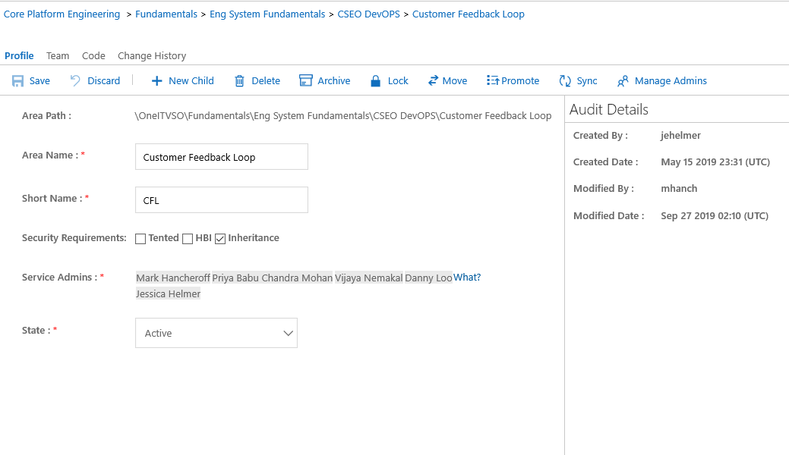
Increasing engineering productivity
Extending Azure DevOps
Due to the size and complexity of our organization we build services on top of Azure DevOps, to reduce the manual effort on engineers and ensure they have move time to focus on building their services
Artifact Management
Mapping of metadata between service, area path, repos and valid users
Application of security classifications to protect sensitive information
Azure DevOps Archival
Clean up legacy engineering artifacts from ADO
Effective utilization of Azure resources
Data retention policy prior to permanent deletion
OrgName\Offering\Service\Component…
Jane Doe
John Smith

Slide 22
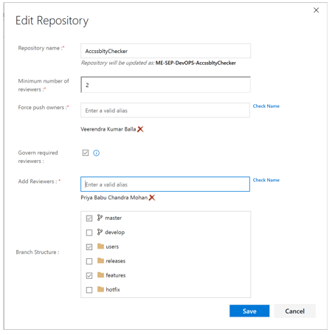
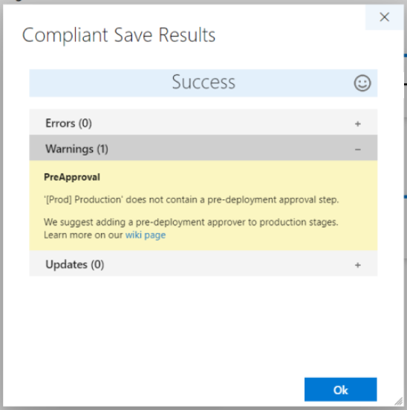
Raising quality with integrated policies
Over 60% of CSEO engineers were non-FTEs, integrating policies directly into our pipelines was key to ensuring high quality, consistent and compliant code
Branch Management
Compliant save
Consistency in the branching structure
Enforce minimum number of code reviewers
Required reviewers at the repo level
Move quality checks upstream to build/release definition design time
Catch problems before they’re even deployed
Notes:
Needs more on the WHY!
Why are policies important?
Vendor staff - Lots of vendors
Policies – check into Master/ CRs
Release from Master best practice to help people to move to Dev Ops – consistent integrating

Slide 23
Listen to the customers

Slide 24
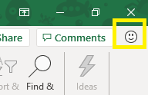
Feedback-driven development
What is Feedback Driven Development?
Business and product investment decisions based on input from a well-established, scalable, and clear customer feedback loop
Foundation for hypothesis-driven product improvements based on actual sentiment and usage data
One customer voice
Outcomes
Contextual in-app feedback experience for end users using standardized service called One Customer Voice (send-a-smile from Office retail apps)
Multi-channel feedback storage in a single backend system
Feedback funnel and triage process from a spectrum of sources
Culture change to build customer feedback capturing, triaging and analysis into team's day to day workflows and how they plan their work

Slide 25
What have we learned?

Slide 26
Key lessons we have learned
Lesson 1: Success to modernizing our engineering is being vision-led and metric driven
Lesson 2: Transformation cuts across people, process and technology
Lesson 3: Requirement to invest the time up front in burning down technical debt
Lesson 4: Transformation is an opportunity to lead E2E thinking
Lesson 5: Be consistent throughout the journey and carefully prioritize goals and metrics

